Slide 1













J.B.INSTITUTE OF ENGINEERING AND TECHNOLOGY
(UGC AUTONOMOUS)
Accredited by NAAC & NBA, Approved by AICTE & Permanently Affiliated to JNTUH
Organized by

Slide 2
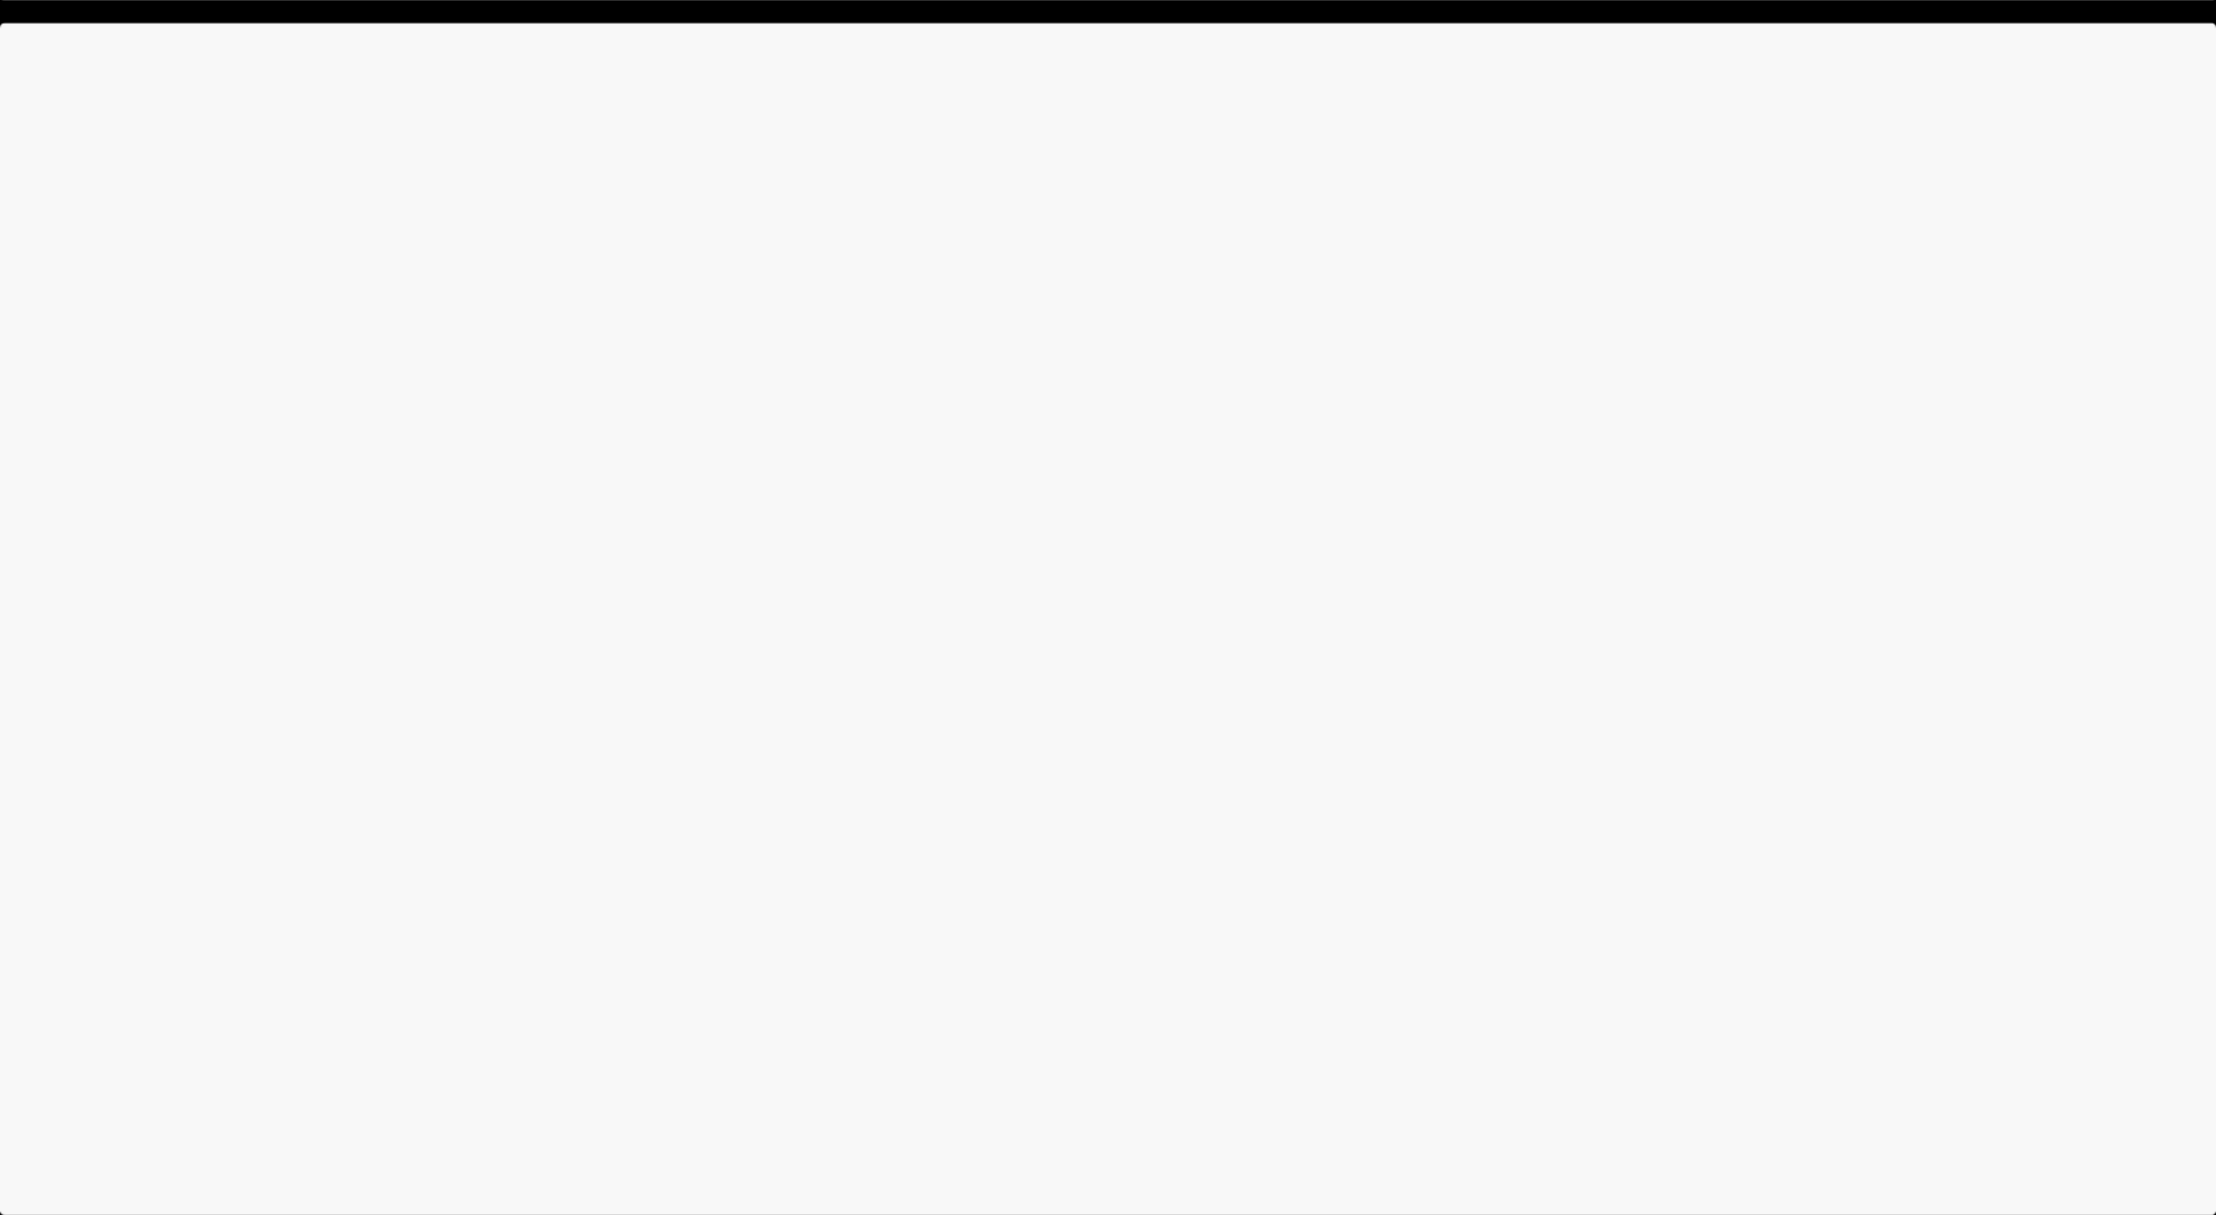

TEAM DETAILS
1
Selected Track -
AGRITECH
2
Problem Statement Title -
Crop diseases often go undetected until it's too late, causing major losses
3
CodeBlooded
Team Name -
4
Mohammed Raif Fudail
Team Lead -
5
Dept. Name -
CSE(AIML)

Slide 3
IDEA TITLE
Agro Aid is an innovative AI-driven web application designed to assist farmers in identifying crop diseases in real-time. By combining Artificial Intelligence, Voice Recognition, Multilingual Translation, and Weather Integration, AgroAid empowers farmers to detect plant diseases, receive instant treatment suggestions, and interact with the system in their own language — making modern agricultural technology accessible to everyone.
Key Features:
⇒ Real-time crop disease detection using AI
⇒ Voice-based interaction for easy use
⇒ Multilingual translation through Google Translate API
️ ⇒ Weather and location-based insights
⇒ Simple, farmer-friendly user interface

Slide 4
TECHNICAL APPROACH
⇒ User Interaction Layer (Frontend)
• The user accesses the app through an intuitive web interface built with HTML, CSS, and JavaScript.
• Features include:
• Crop image upload
• Voice input for farmer queries
• Real-time disease results and weather updates
⇒ API & Communication Layer
• The frontend communicates with the Flask Backend API via HTTP (JSON format).
• Data flow:
• Image & voice data → Backend
• AI analysis & translated text → Frontend display
⇒ AI Processing Layer
• The backend uses a trained Convolutional Neural Network (CNN) or Efficient Net model to analyze crop leaf images.
• Model outputs:
• Disease name
• Confidence percentage
• Recommended solution
⇒ External APIs
• Google Translate API → Translates farmer’s speech into English.
• OpenWeather API → Fetches live weather data using location.
• Geolocation API → Determines user coordinates for contextual disease prediction.
⇒ Output Layer
• Displays disease results, weather information, and suggestions in a clean, visual dashboard.
• Provides an option for continuous data logging for future model improvement.

Slide 5
FEASIBILITY AND VIABILITY
⇒ Technical Feasibility:
Agri Aid utilizes reliable open-source technologies such as Flask for the backend, TensorFlow for AI-based crop disease detection, and Google APIs for translation and weather integration. The system architecture is modular, enabling scalability, easy updates, and smooth integration with external platforms like WhatsApp.
⇒ Operational Feasibility:
The solution is designed for simplicity and accessibility. Features such as voice input, multilingual translation, and image-based diagnosis ensure that farmers with minimal technical literacy can use the platform effectively. Deployment can be done via web or mobile interfaces for broad outreach.
⇒ Economic Feasibility:
AgriAid’s development leverages open-source frameworks, minimizing costs. Hosting and maintenance expenses are low, and potential partnerships with agricultural institutions or NGOs can ensure long-term sustainability.
⇒ Social Viability:
The project contributes to rural empowerment by providing accessible, data-driven agricultural support. It enhances productivity, reduces crop losses, and bridges the technological gap for small-scale farmers, thereby promoting sustainable agricultural practices.

Slide 6
IMPACT AND BENEFITS
⇒ Farmers can speak in their own language, and your system automatically understands and translates to English for the AI model.
⇒ When used alongside the speech recognition system (mic input), it allows your app to:
• Listen to farmer queries in any language.
• Translate instantly into English for backend processing.
• Return accurate results — diseases, remedies, or weather data — in seconds.
⇒ Impact: Makes the AI interaction natural, voice-driven, and intuitive, even for non-technical users.
Long-Term Societal Benefit
• Helps digitally empower farmers with low literacy.
• Encourages adoption of AI in agriculture.
• Can be extended for market prices, pest alerts, or fertilizer suggestions in local languages.

Slide 7
Team Member's Information
Team Leader Name: MOHAMMED RAIF FUDAIL
Year: 2nd Year Department: CSE(AIML) Roll Number:24671A6640
Team Member 1 Name: MOHAMMED ARHAAN AKHTER
Year: 2nd Year Department: CSE(AIML) Roll Number:24671A6641
Team Member 2 Name: SHAIK SHURAIM
Year: 2nd Year Department: CSE(AIML) Roll Number:24671A6657
Team Member 3 Name: ABDUL SUHEEB ARSH
Year: 2nd Year Department: CSE(AIML) Roll Number:24671A6602

